Slide 1

By
Sai Rohini Godavarthi

Slide 2
OVERVIEW
Introduction
Objectives
Dataset
Exploratory Data Analysis
- Data Loading
- Data Cleaning
- Data Analysis using Descriptive Statistics
Data Visualization
- Aggregation Visualization
- Map Visualization
- Interactive Visualization

Slide 3

INTRODUCTION
Airbnb has become a cornerstone for travelers seeking convenience and hosts looking to earn extra income. However, amidst the vast array of listings, knowing which type of property to invest in can be challenging for hosts, while travelers strive to find the perfect listing at the right price with desired features. Understanding the factors influencing pricing and the common features among the listings is key. This includes neighborhood influence, room type distribution, and the correlation between price and the number of reviews.

Slide 4
OBJECTIVE
Explore Spatial Distribution: Visualize how Airbnb listings are distributed across various neighborhood groups in New York City to understand where demand is highest and where potential hosts could invest for optimal returns.
Visualize Pricing Trends and Room Types: Visualize the distribution of listings based on room types and prices to identify trends and variations in pricing, as well as popular room types in different areas.
Compare Price Differences Among Boroughs: Examine average prices and room type distributions between key boroughs such as Manhattan, Brooklyn, Queens, and others to determine if certain areas offer better value or higher returns for hosts and appeal more to travelers.
Implement Interactive Filtering: Add interactivity to the presentation to allow users to filter listings by price ranges and neighborhood groups, enabling both hosts and travelers to make informed decisions based on their preferences and budgets.

Slide 5
DATASET
Data Overview: The dataset consists of 39,391 rows, providing a comprehensive dataset for analysis.
Source of Data: The dataset was obtained from Inside Airbnb, ensuring reliability and accuracy. (https://insideairbnb.com/get-the-data/)
Project Focus: The project focused on visualizing Airbnb listings in New York City, utilizing the dataset to gain insights into pricing trends, spatial distribution, and other relevant factors.
Approach: Through this visualization, we aimed to understand the characteristics of Airbnb listings in New York City and provide valuable insights for hosts and travelers alike.

Slide 6
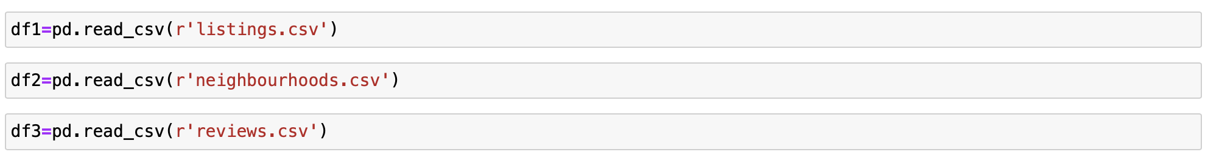
LOADING THE DATASET

Slide 7
DATA CLEANING

Slide 8
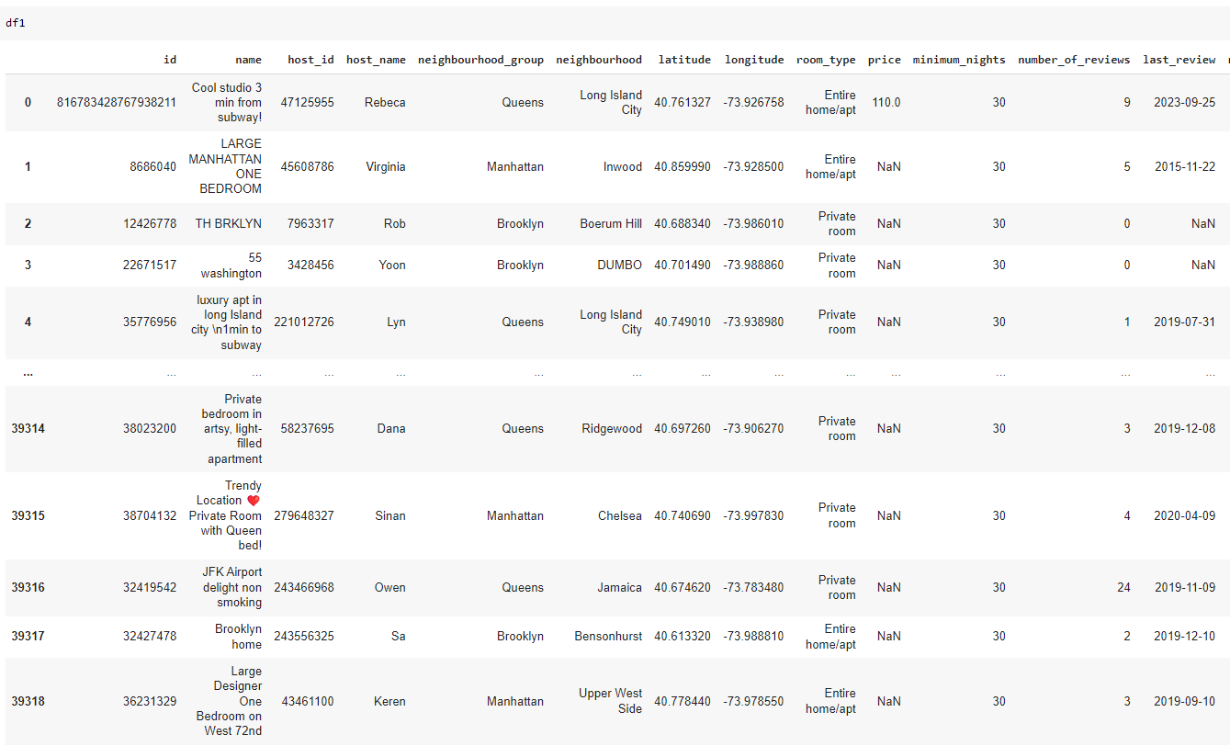
LISTINGS.CSV

Slide 9
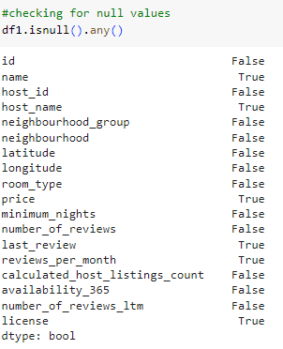
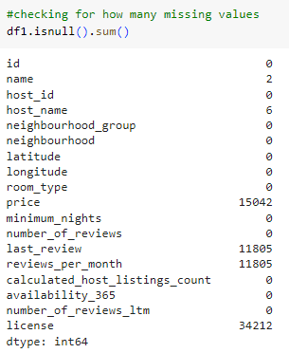
Checking the Missing Values in df1

Slide 10
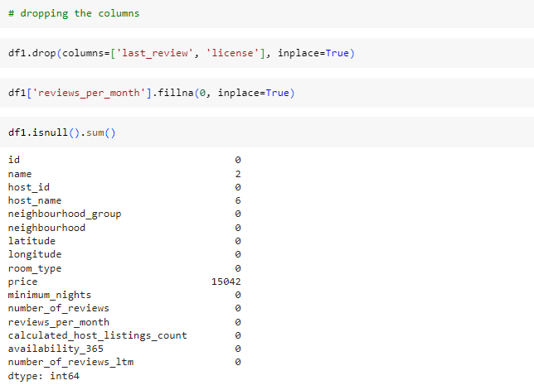
Dropping/Filling the columns

Slide 11
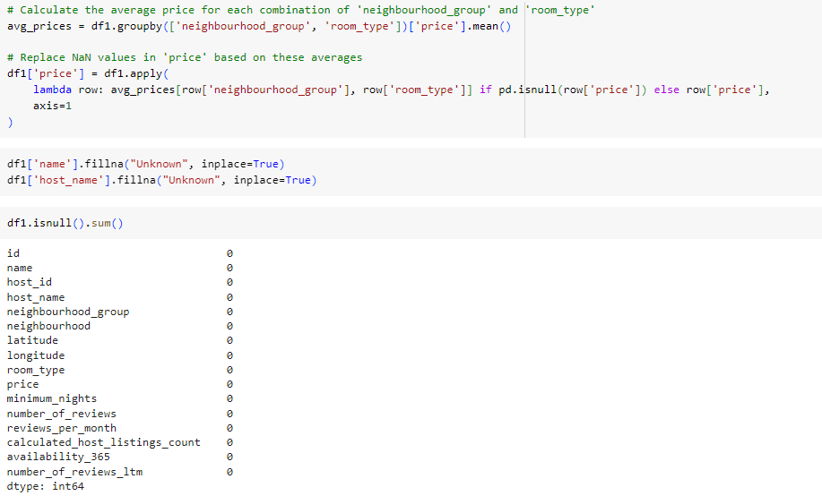
Filling the NaN values

Slide 12
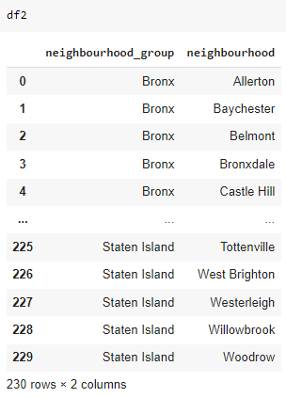
Neighbourhoods.CSV

Slide 13
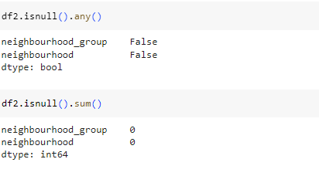
Checking the Missing Values in df2

Slide 14
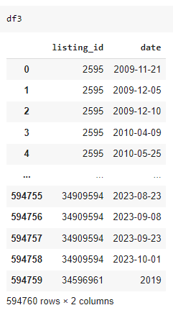
REVIEWS.CSV

Slide 15
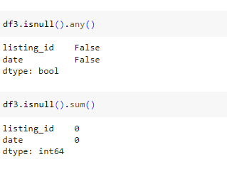
Checking the Missing Values in df3

Slide 16
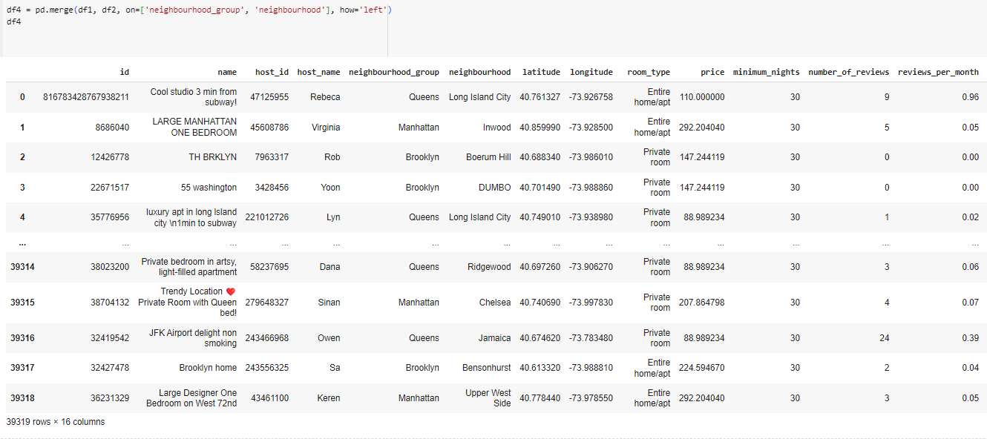
MERGING

Slide 17
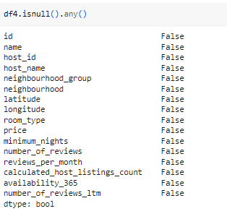
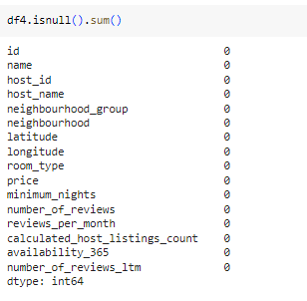
Checking the missing values in df4

Slide 18
DESCRIPTIVE STATISTICS

Slide 19
Summary Statistics
Summary statistics provide a concise overview of key characteristics within a dataset, including measures such as mean, median, minimum, maximum, and standard deviation, offering insights into central tendencies, variability, and distribution of the data.

Slide 20
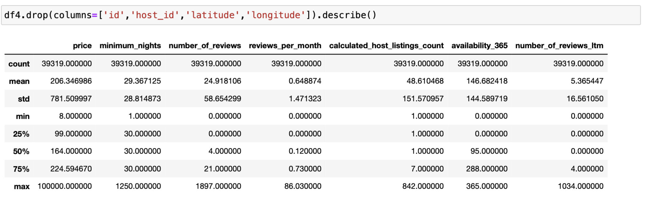
Summary Statistics – df4

Slide 21
Observations from Summary Statistics – df4
Price: The average price per night across listings is approximately $206.35, with a standard deviation of $781.51, indicating a wide range of prices. The minimum price is $8, while the maximum price is $100,000, showcasing significant variability in pricing.
Minimum Nights: On average, listings require guests to stay for approximately 29.37 nights, with a standard deviation of 28.81. The minimum duration for a stay is 1 night, while the maximum is 1250 nights.
Number of Reviews: The average number of reviews per listing is approximately 24.92, with a standard deviation of 58.65, indicating substantial variation. The range of reviews varies from 0 to 1897, with a median of 4 reviews.
Reviews Per Month: Listings receive approximately 0.65 reviews per month, with a standard deviation of 1.47. Some listings may have high review frequencies, as evidenced by the maximum of 86.03 monthly reviews.
Calculated Host Listings Count: Hosts, on average, have approximately 48.61 listings, with a standard deviation of 151.57. The range of host listings varies from 1 to 842, indicating a wide disparity in the number of listings per host.
Availability 365: Listings are, on average, available for approximately 146.68 days in a year, with a standard deviation of 144.59. Availability ranges from 0 to 365 days, with some listings available throughout the year.
Number of Reviews Last Twelve Months (LTM): The average number of reviews received in the last twelve months is approximately 5.37, with a standard deviation of 16.56. Some listings may have a high volume of recent reviews, as evidenced by the maximum of 1034 reviews.

Slide 22
DATA VISUALIZATION

Slide 23
Aggregation Visualization

Slide 24
How does the distribution of prices vary among different room types?

Slide 25
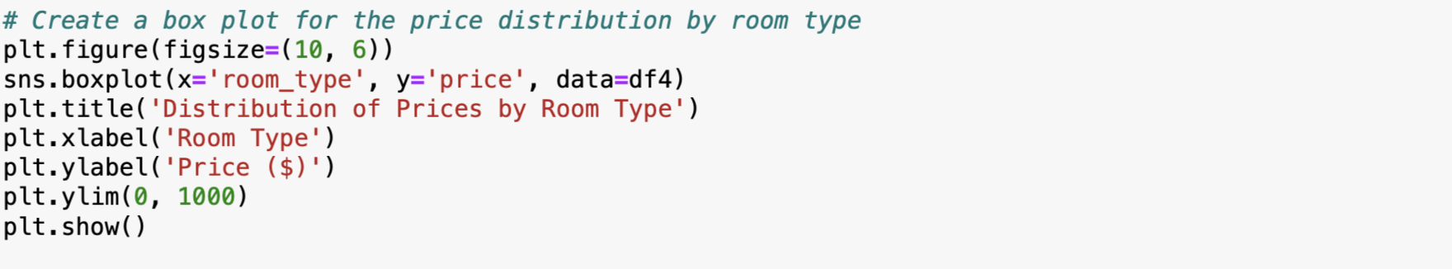
CODE

Slide 26
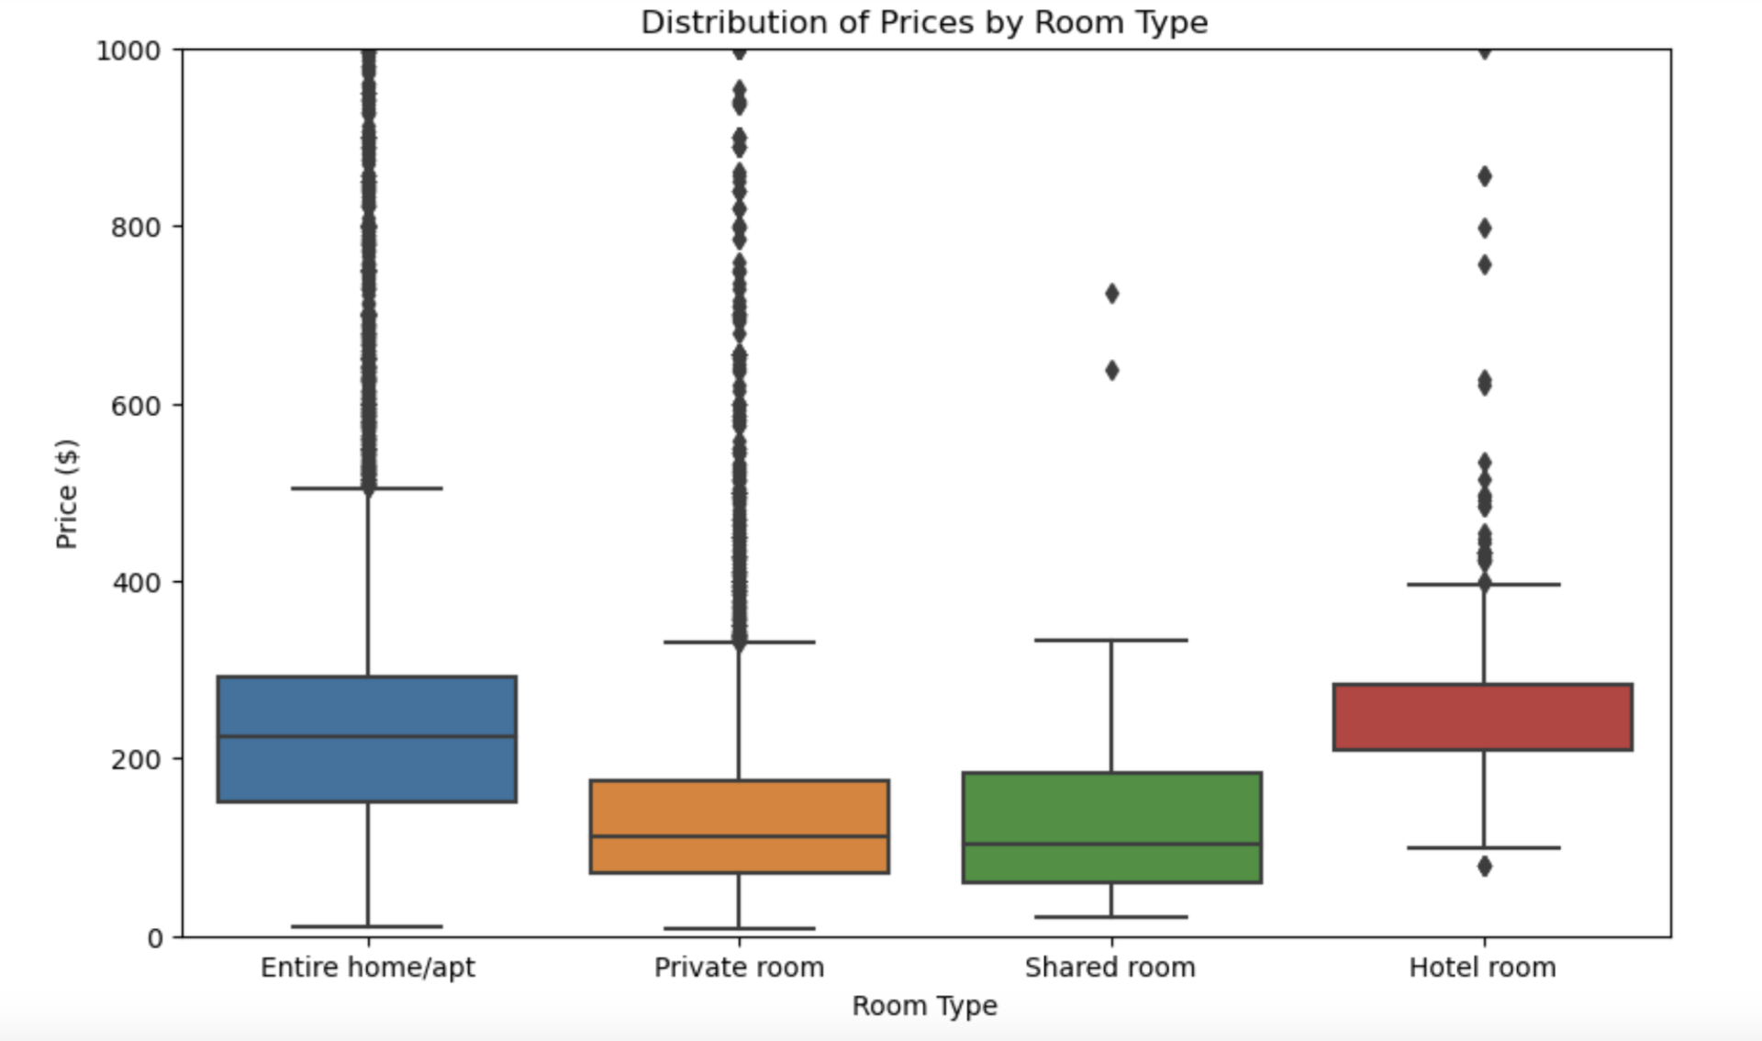
Box Plot

Slide 27
Summary:
Mean Price:
Entire home/apt: The mean price for an entire home or apartment is $252.54.
Hotel room: Hotel rooms have a mean price of $280.17, which is slightly higher than entire homes/apartments. However, it's important to note that there are fewer hotel room listings compared to other room types.
Private room: The mean price for a private room is $153.76, significantly lower than entire homes/apartments and hotel rooms. Private rooms generally offer a more affordable option for travelers.
Shared room: Shared rooms have the lowest mean price at $127.80, indicating they are the most budget-friendly option among all room types.

Slide 28
Price Range:
Minimum and Maximum Prices: The minimum and maximum prices show the range of prices within each room type. For instance, the minimum price for an entire home/apt is $10, while the maximum is $10,000, indicating a wide range of price options.
Quartiles (25th, 50th, 75th Percentiles): The quartiles provide insight into the distribution of prices. For example, for entire home/apartments, 25% of listings have prices below $150, while 75% have prices below $292.20.
Standard Deviation: The standard deviation measures the spread of prices around the mean. A higher standard deviation suggests a wider variability in prices. For instance, hotel rooms have a relatively lower standard deviation compared to entire homes/apartments, indicating less variability in prices.

Slide 29
Is there any correlation between the price of listings and the number of reviews they receive?

Slide 30
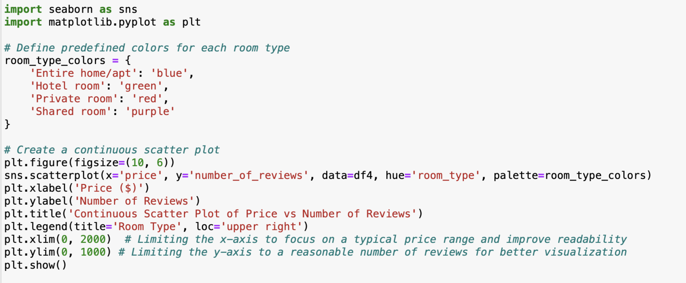
CODE

Slide 31
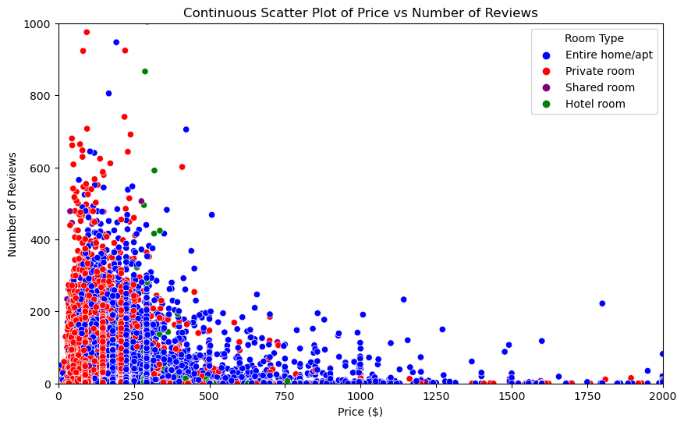
Continuous Scatter Plot

Slide 32
Summary:
Scatter Plot Visualization: The plot displays the relationship between the price of Airbnb listings (in dollars) and the number of reviews they receive.
Room Types: Each point on the plot represents an Airbnb listing, and the color of the point indicates the room type (e.g., Entire home/apt, Hotel room, Private room, Shared room).
Interpretation:
Price vs Number of Reviews: As we move along the x-axis (price), we can observe how the number of reviews changes.
Room Type Distribution: The color coding helps to distinguish different room types, allowing us to see how listings of each type are distributed.
Upon observing the plot, we notice an interesting trend - lower-priced listings tend to receive more reviews. This indicates an inverse correlation between price and the number of reviews. In other words, as the price decreases, the number of reviews tends to increase.
Room Type Influence:
Entire Home/Apt and Private Room: Listings categorized as Entire home/apt and Private room, especially at lower prices, attract a higher number of reviews compared to higher-priced listings of the same types. This suggests that guests might be more inclined to leave reviews for affordable entire home/apartment or private room listings.
Shared Room and Hotel Room: Conversely, shared room and hotel room listings, regardless of price, receive comparatively fewer reviews. This could indicate that guests have different expectations or experiences when booking shared or hotel room accommodations.

Slide 33
Map Visualization

Slide 34
How does the average price vary across different neighbourhood groups in New York City?

Slide 35
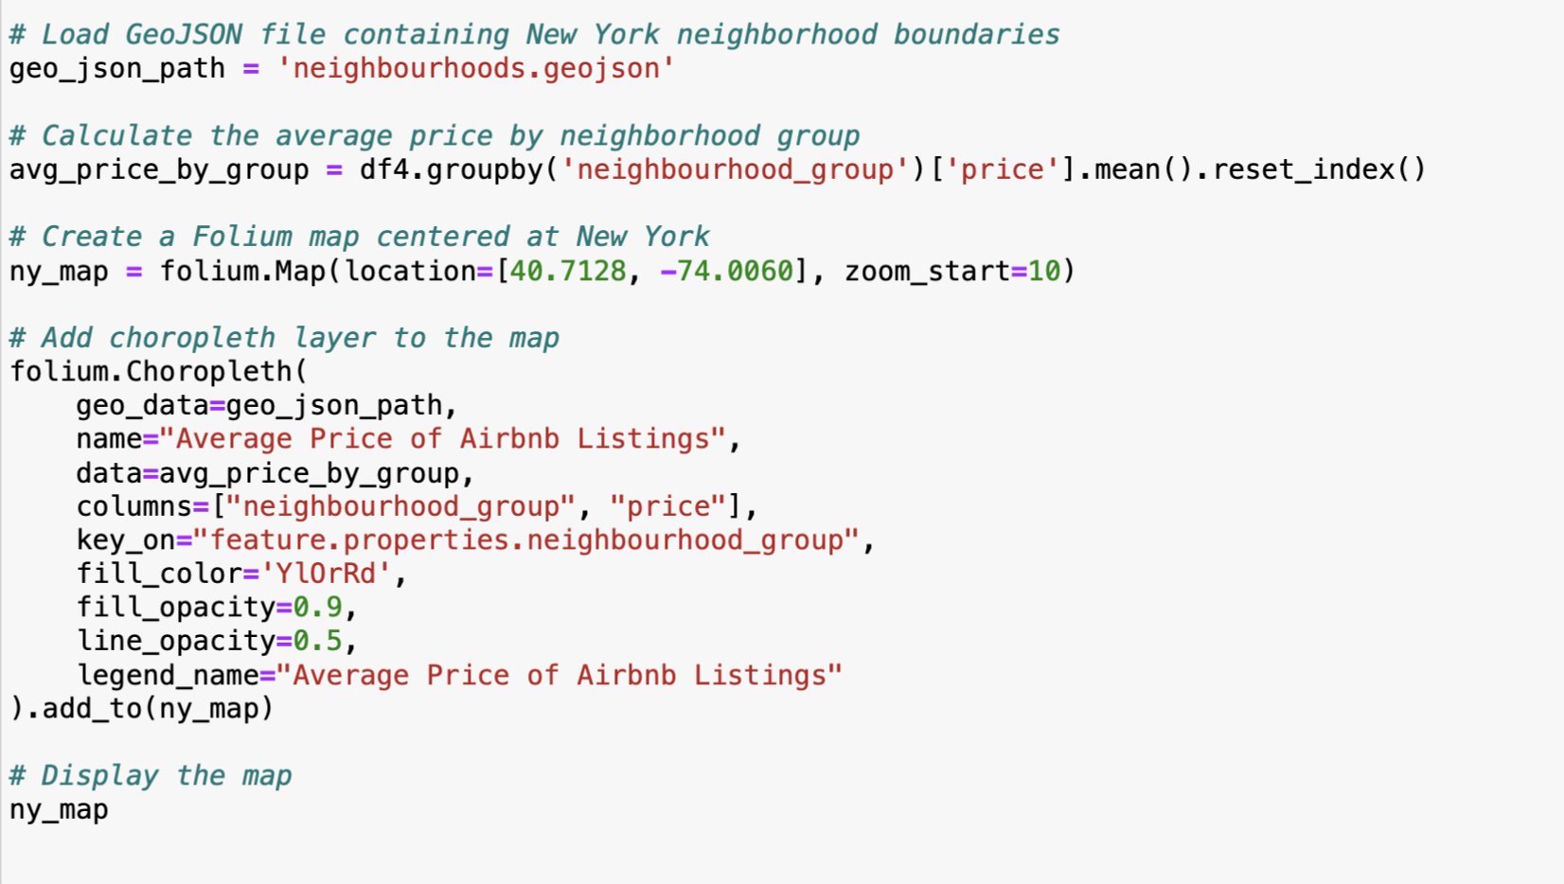
CODE

Slide 36
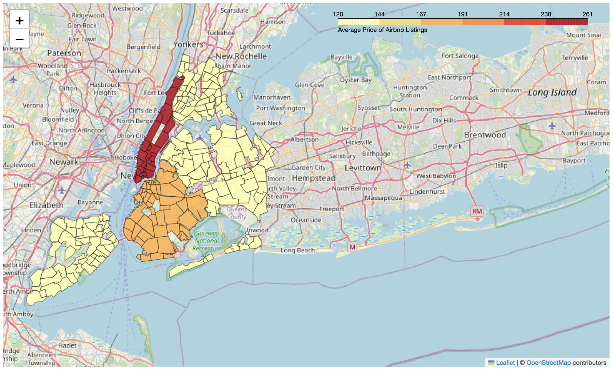
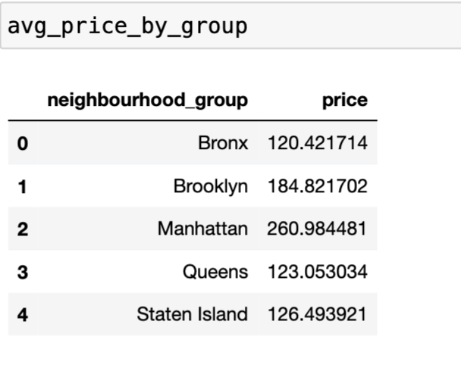
CHOROPLETH MAP

Slide 37
Summary:
In the choropleth map, we have visualized the average prices of Airbnb listings across different neighborhood groups in New York City:
Manhattan:
Manhattan stands out with the highest average price of approximately $261 per night.
This is expected as Manhattan is known for its prime location, tourist attractions, and higher cost of living.
Brooklyn:
Brooklyn follows with an average price of around $185 per night.
While still relatively high, prices in Brooklyn are generally more affordable compared to Manhattan.
Staten Island:
Staten Island has the lowest average price among the boroughs, approximately $126 per night.
This could be attributed to its distance from Manhattan and fewer tourist attractions.
Queens and Bronx:
Queens and Bronx have average prices of around $123 and $120 per night, respectively.
These boroughs offer more budget-friendly options compared to Manhattan and Brooklyn.

Slide 38
Can we visualize the distribution of listings based on their room type and price?

Slide 39
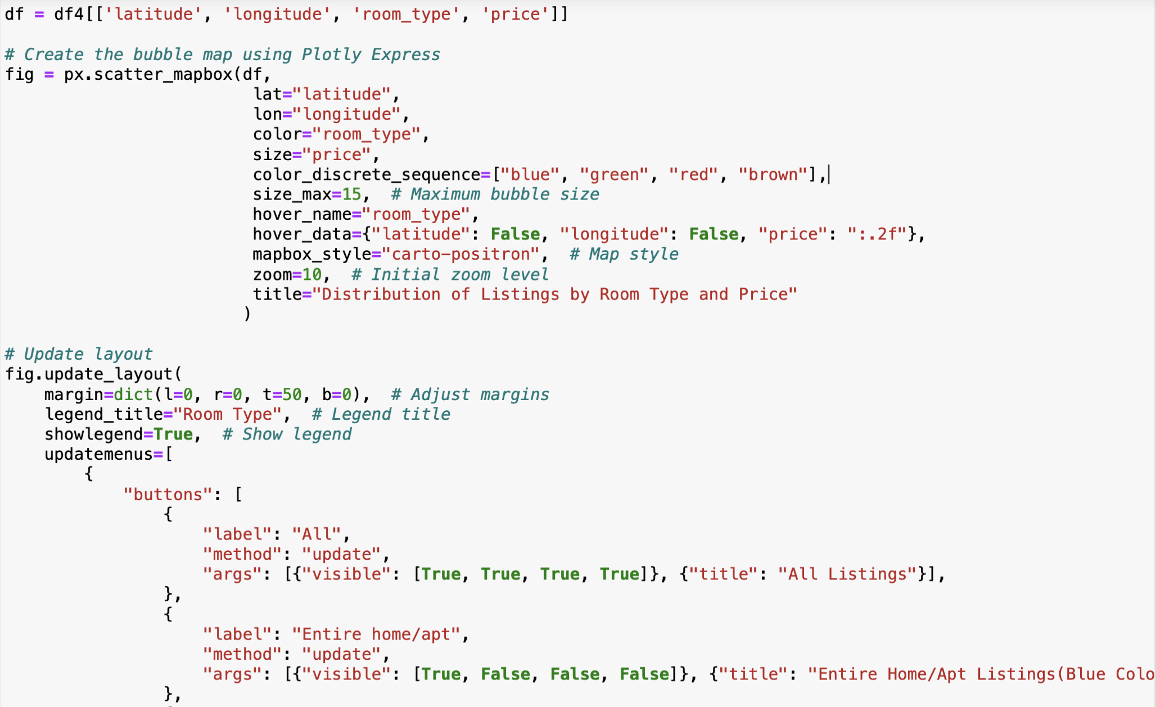
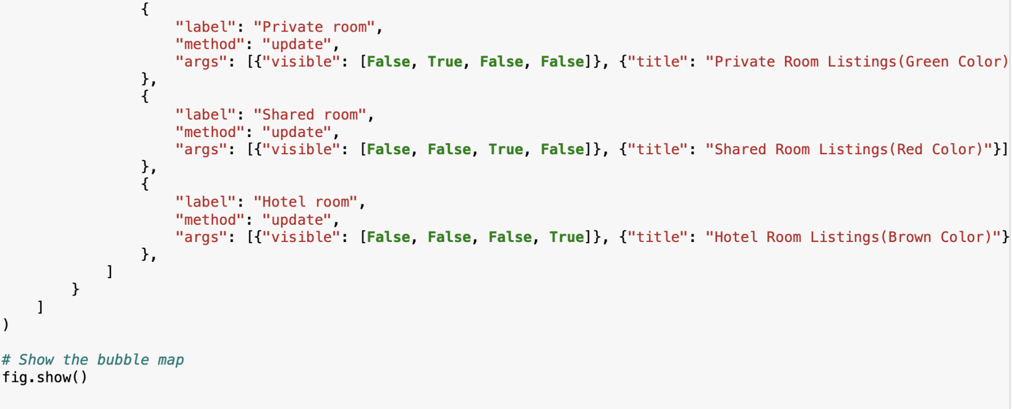
CODE

Slide 40
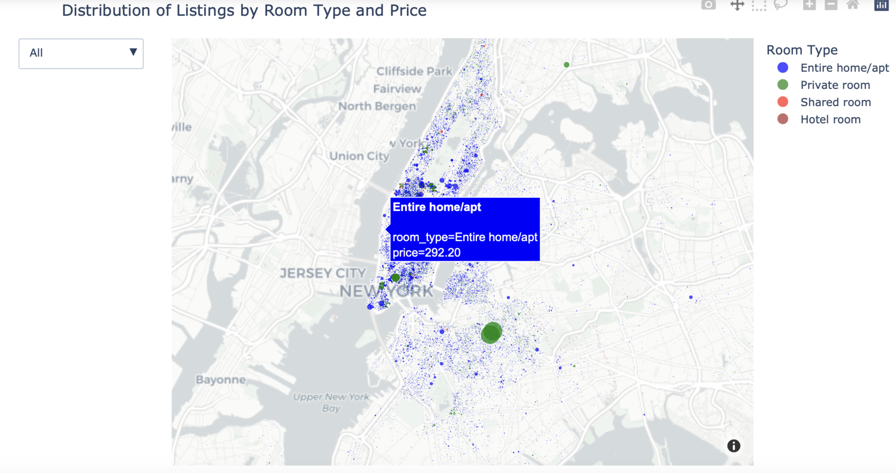
BUBBLE MAP

Slide 41
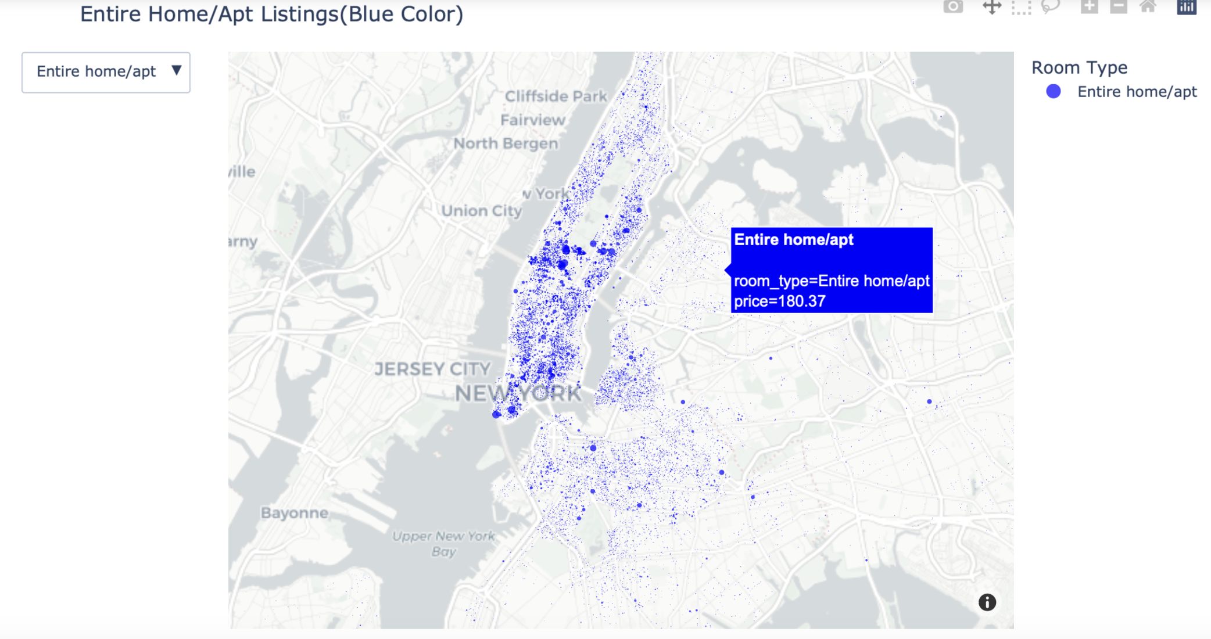

Slide 42
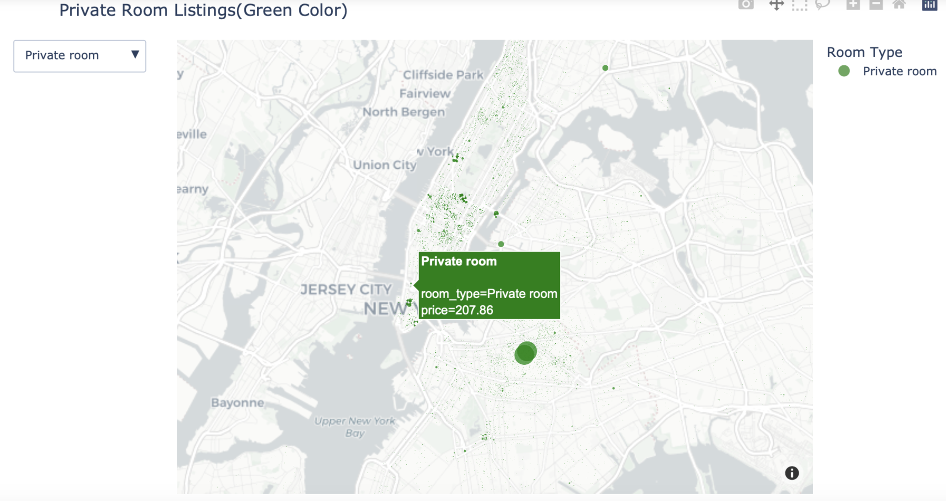

Slide 43
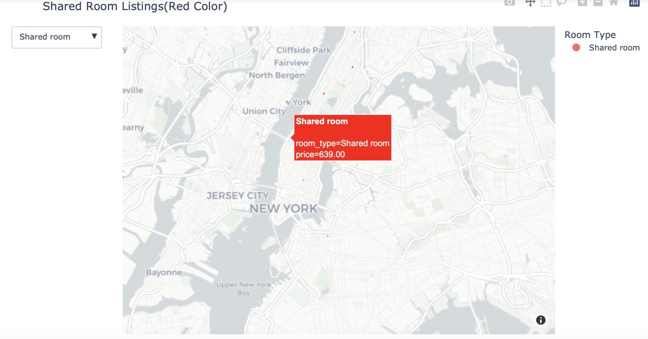

Slide 44
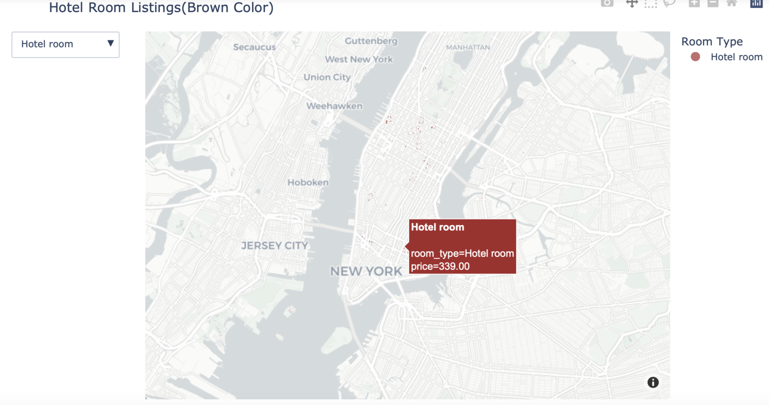

Slide 45
Summary:
The visualization of the distribution of listings based on their room type and price:
Color Representation: The bubble map represents Airbnb listings in New York City, with each bubble indicating a listing's location. The color of the bubble corresponds to the room type:
Blue bubbles represent "Entire home/apt" listings.
Green bubbles represent "Private room" listings.
Red bubbles represent "Shared room" listings.
Brown bubbles represent "Hotel room" listings.
Bubble Size:
The size of the bubbles indicates the price of the listing.
Larger bubbles represent higher-priced listings, while smaller bubbles represent lower-priced listings.
Distribution by Room Type: The map illustrates the spatial distribution of different types of listings across the city.
For example, blue bubbles (Entire home/apt) are more concentrated in certain areas, indicating neighborhoods where entire homes or apartments are popular.
Similarly, green bubbles (Private rooms) are spread across the city, suggesting a more even distribution of private room listings.

Slide 46
Price Variation: The size of the bubbles allows us to quickly identify areas with higher or lower average prices.
Areas with larger bubbles indicate higher-priced listings, while areas with smaller bubbles represent lower-priced listings.
Room Type Preference: We can see the popularity of different room types in various neighborhoods, which can inform pricing strategies and marketing efforts.
For instance, if there's a high concentration of blue bubbles (Entire home/apt) in a particular neighborhood, hosts might adjust their prices accordingly.
Conversely, if there are more green bubbles (Private rooms) in another area, hosts might target budget-conscious travelers with competitive pricing.
Interactive Feature: The interactive legend allows stakeholders to filter the map by room type, enabling them to focus on specific types of listings. This feature provides flexibility in exploring the distribution of listings based on different criteria.

Slide 47
Interactive Visualization

Slide 48
Interactive Aggregation Visualization

Slide 49
Are there any noticeable differences in the average price or room type distribution between Manhattan, Brooklyn, Queens, and other boroughs?

Slide 50
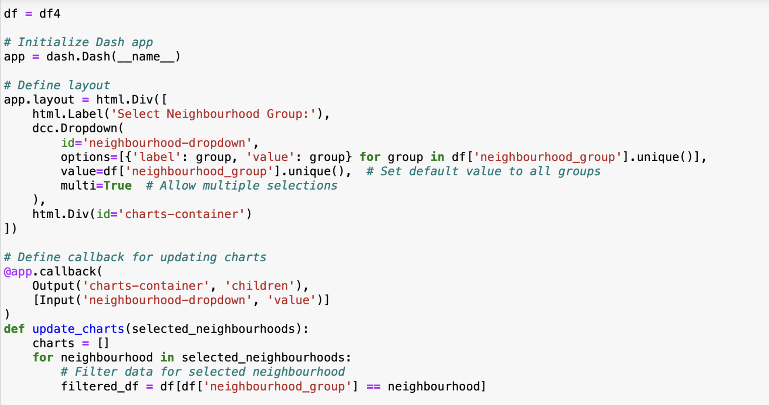
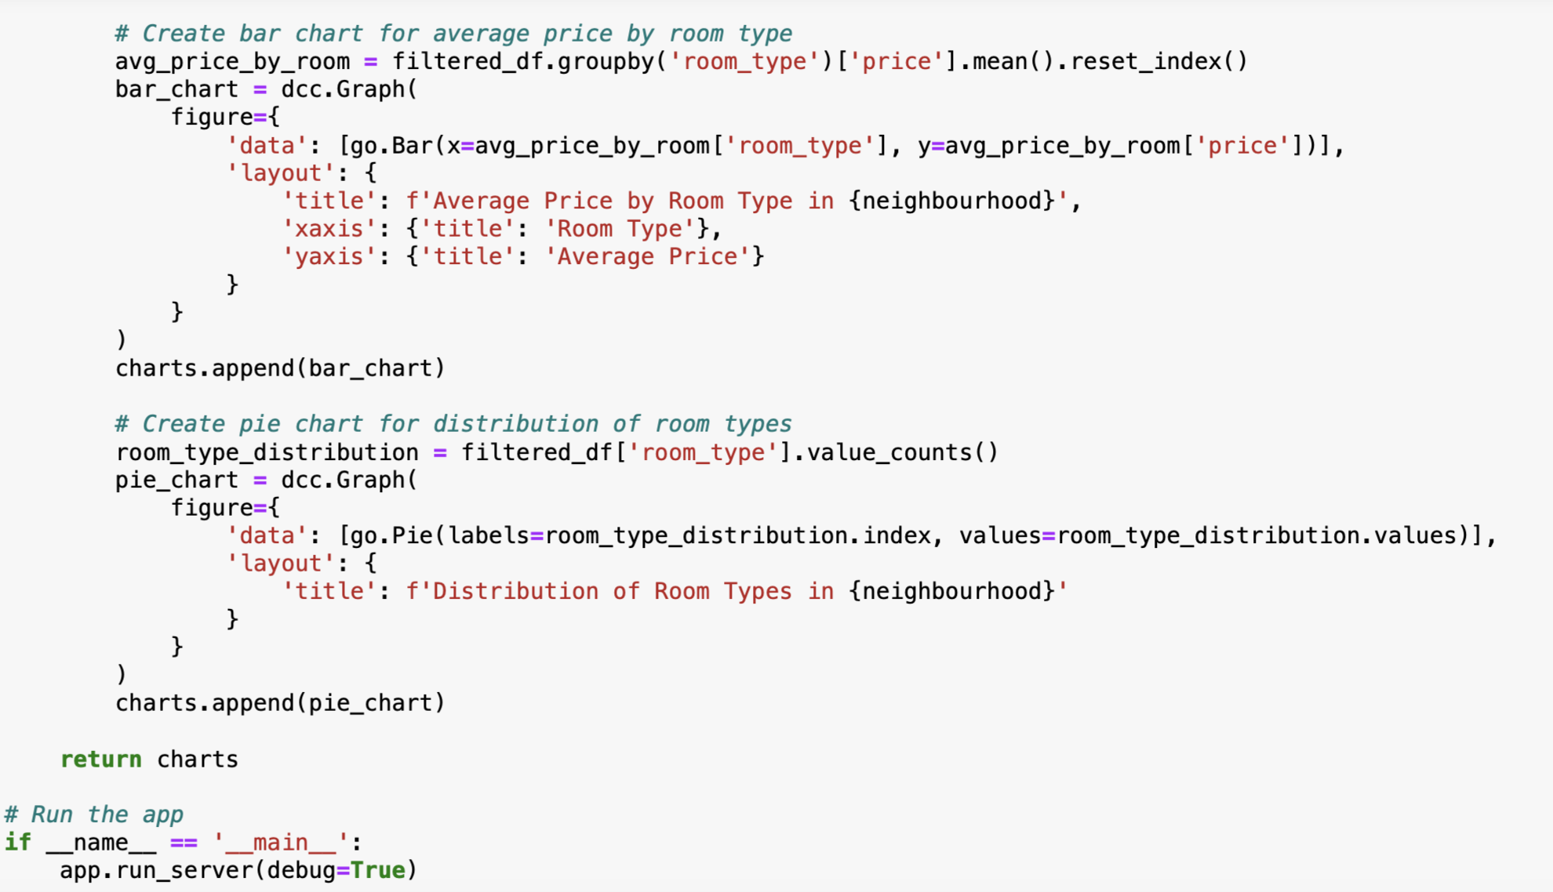
CODE
Notes:
Code for it

Slide 51
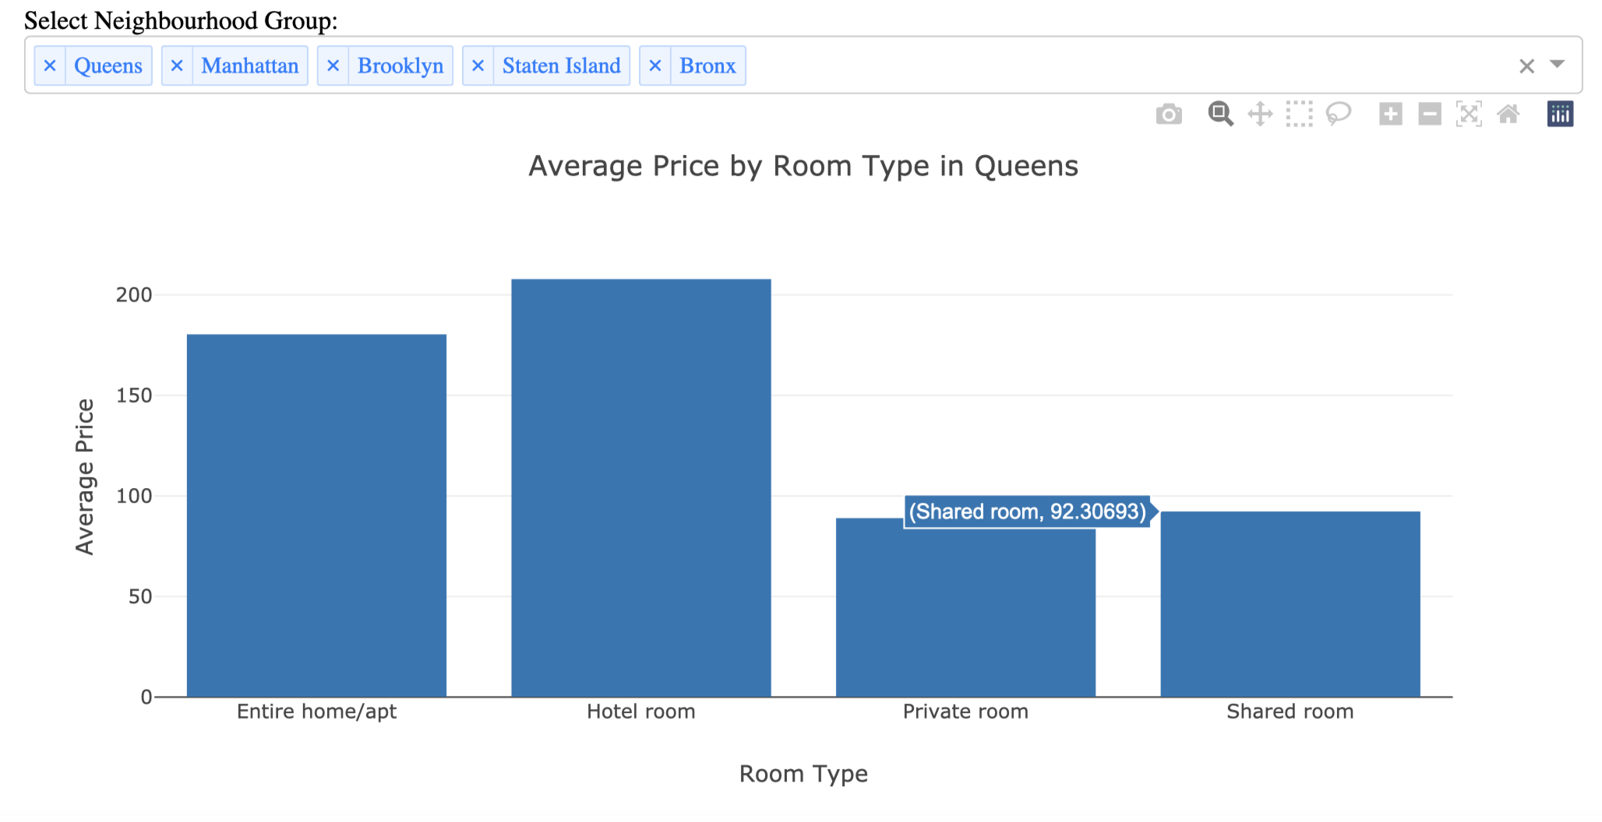
Interactive Aggregation Visualization

Slide 52
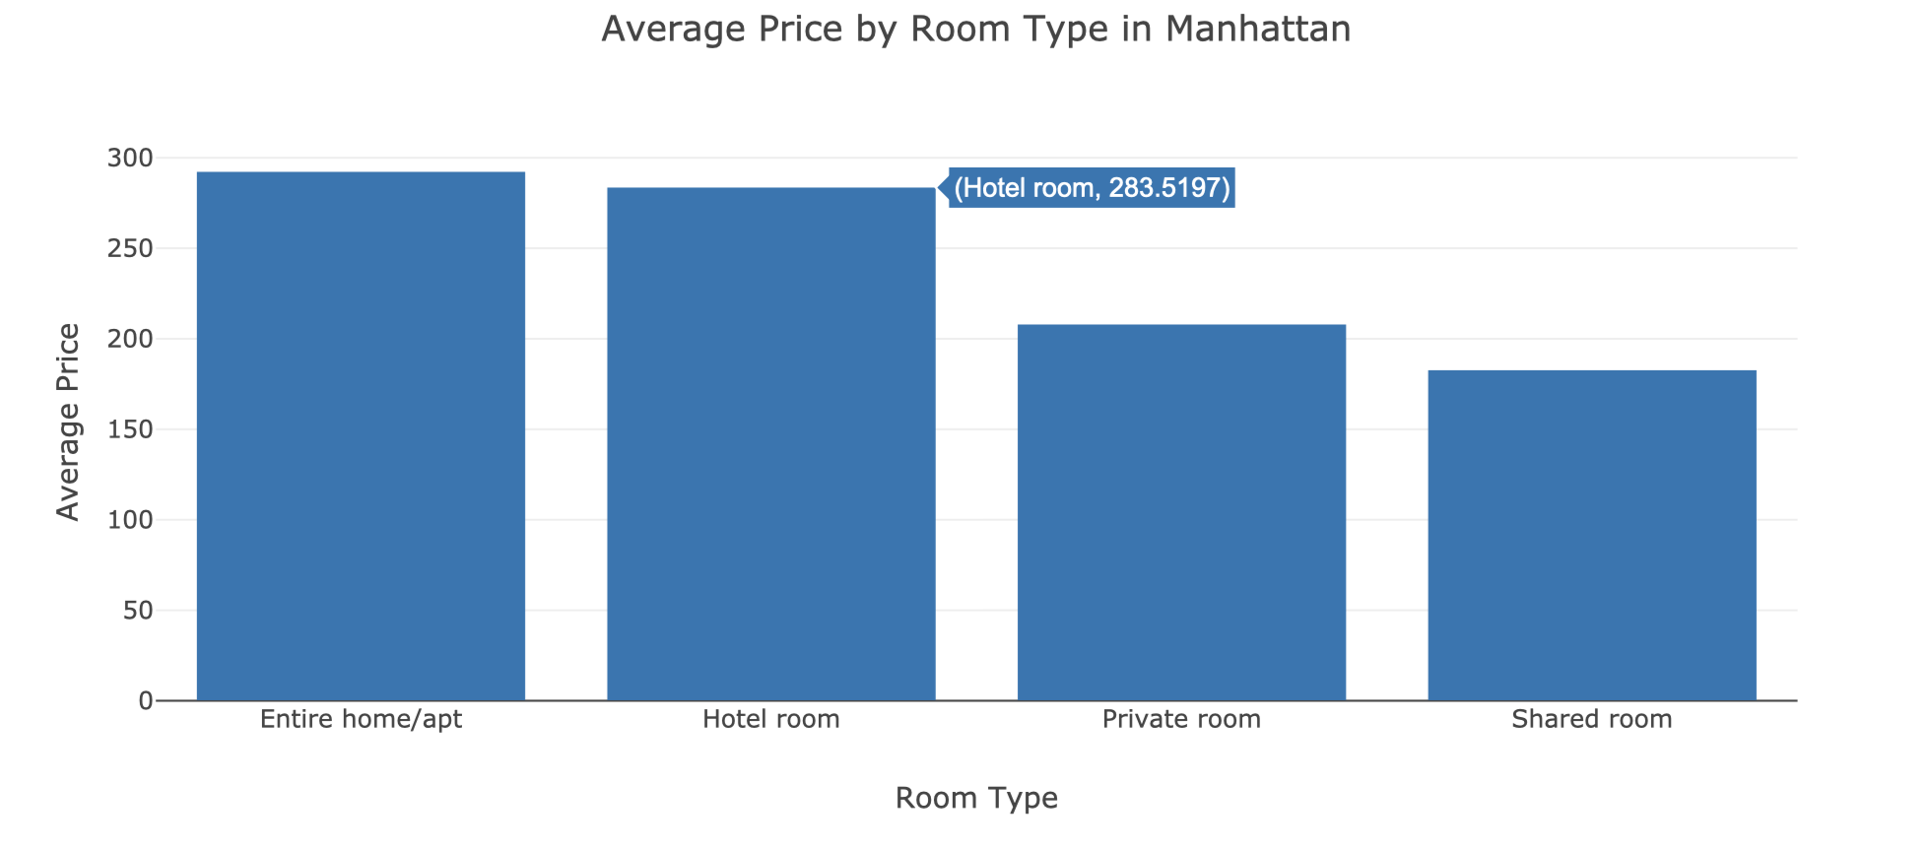

Slide 53
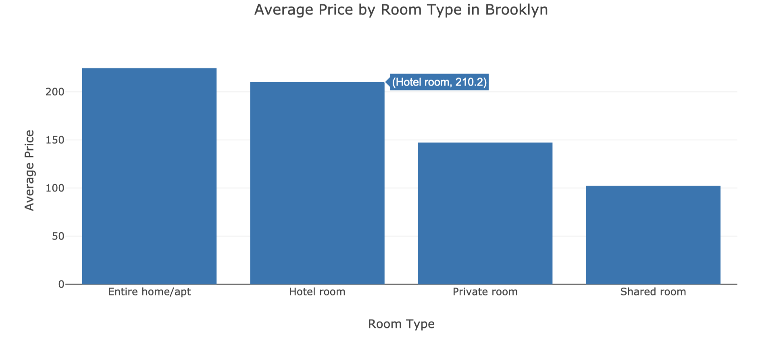

Slide 54
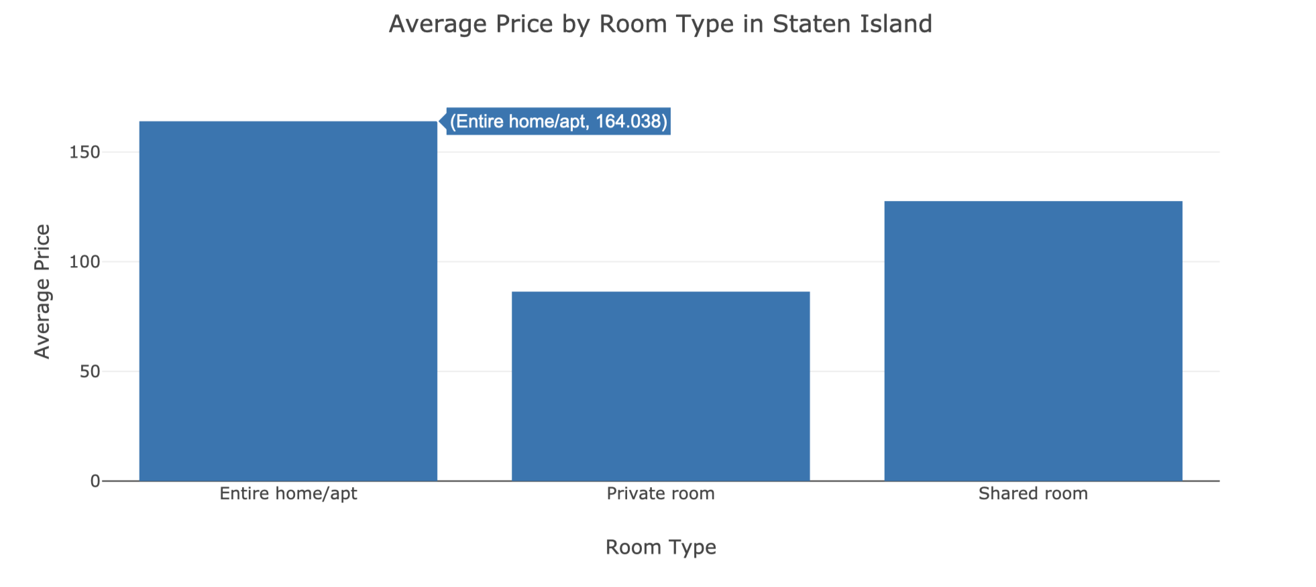

Slide 55
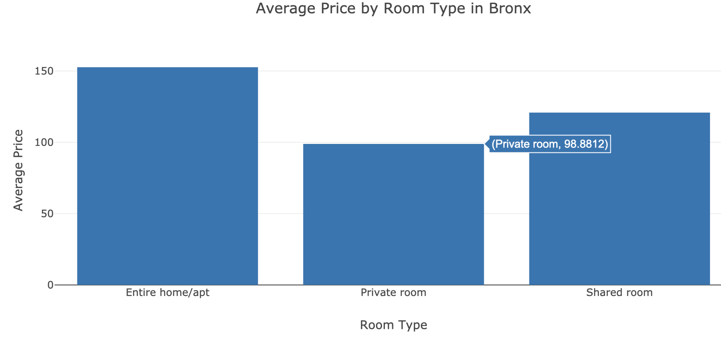

Slide 56
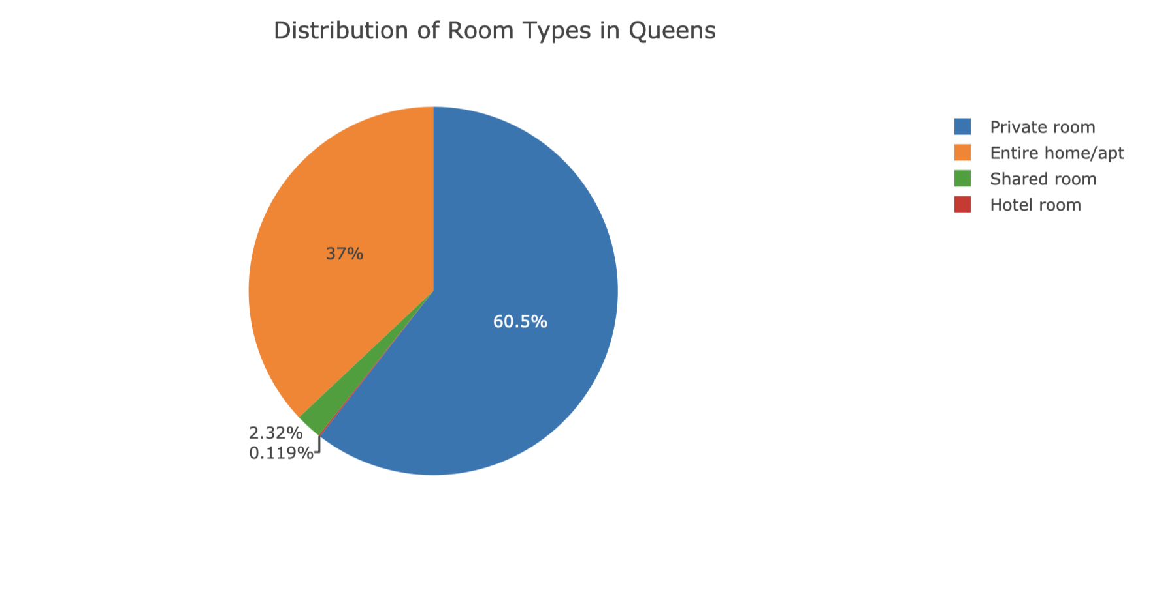

Slide 57
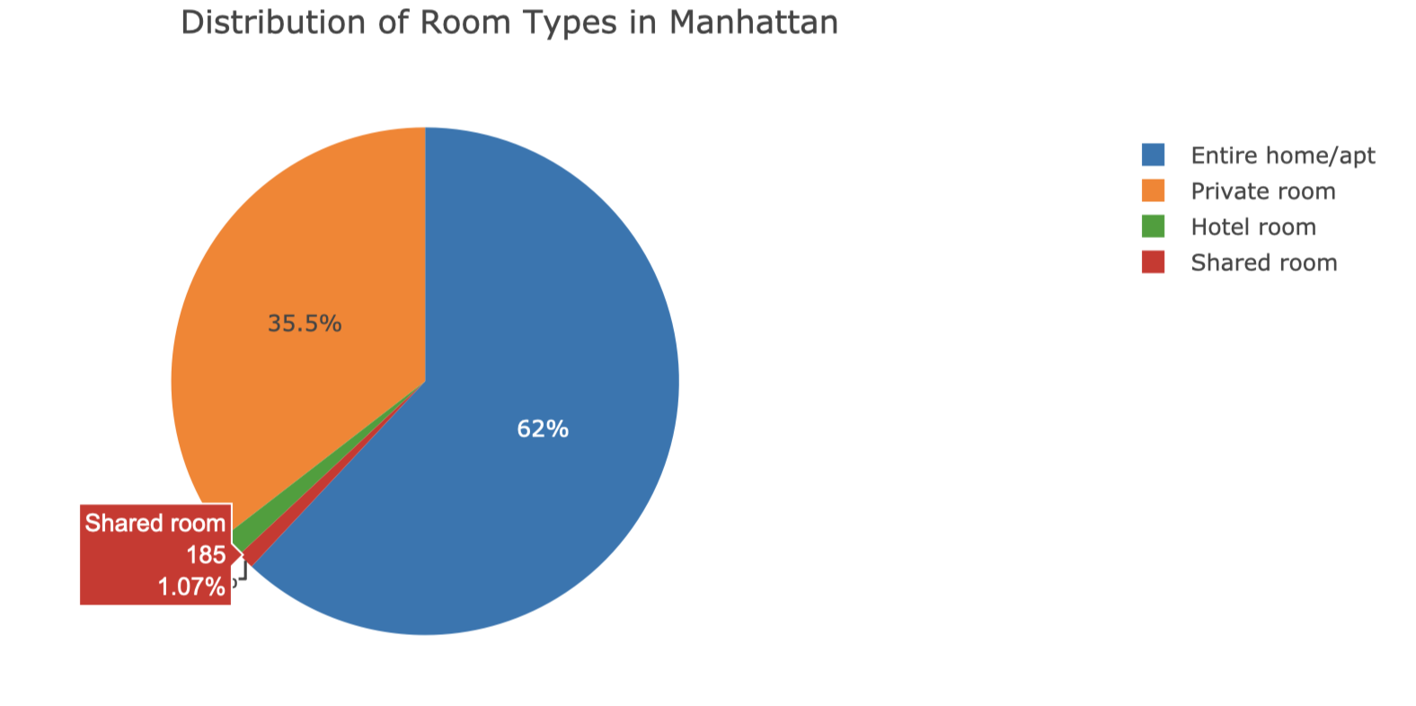

Slide 58
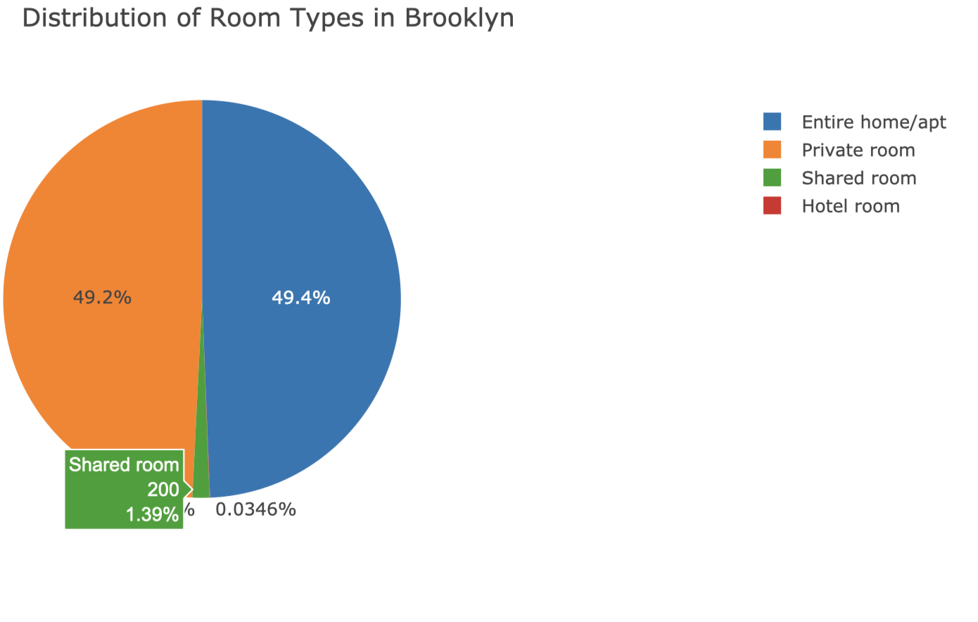

Slide 59
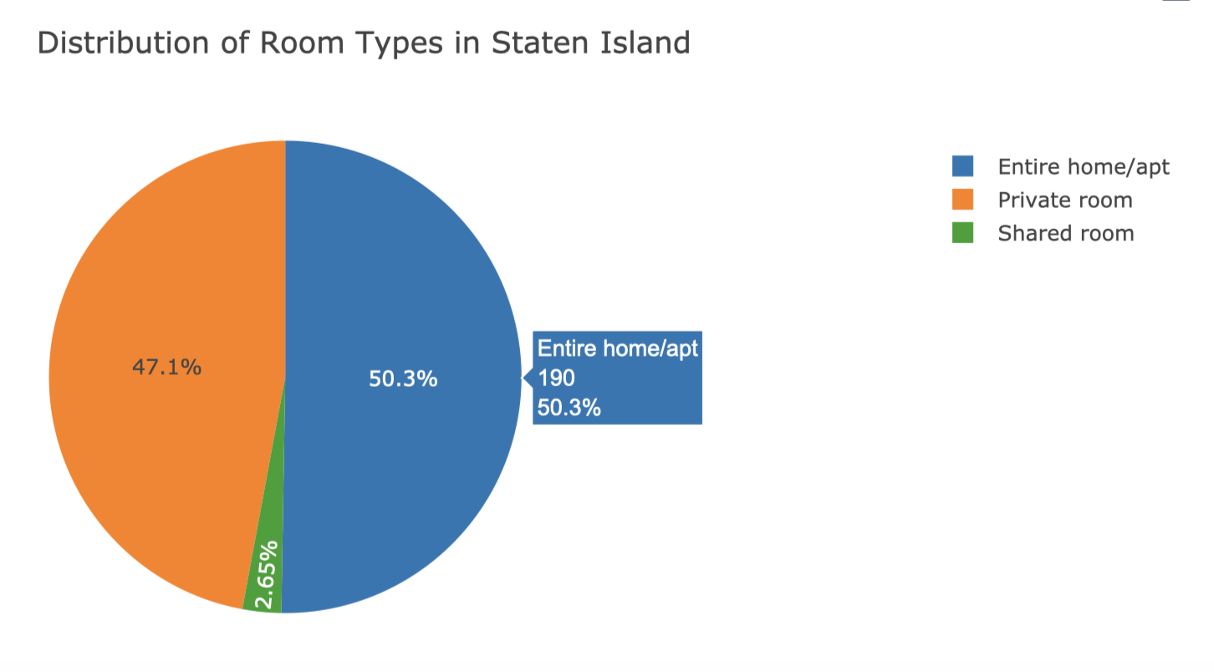

Slide 60
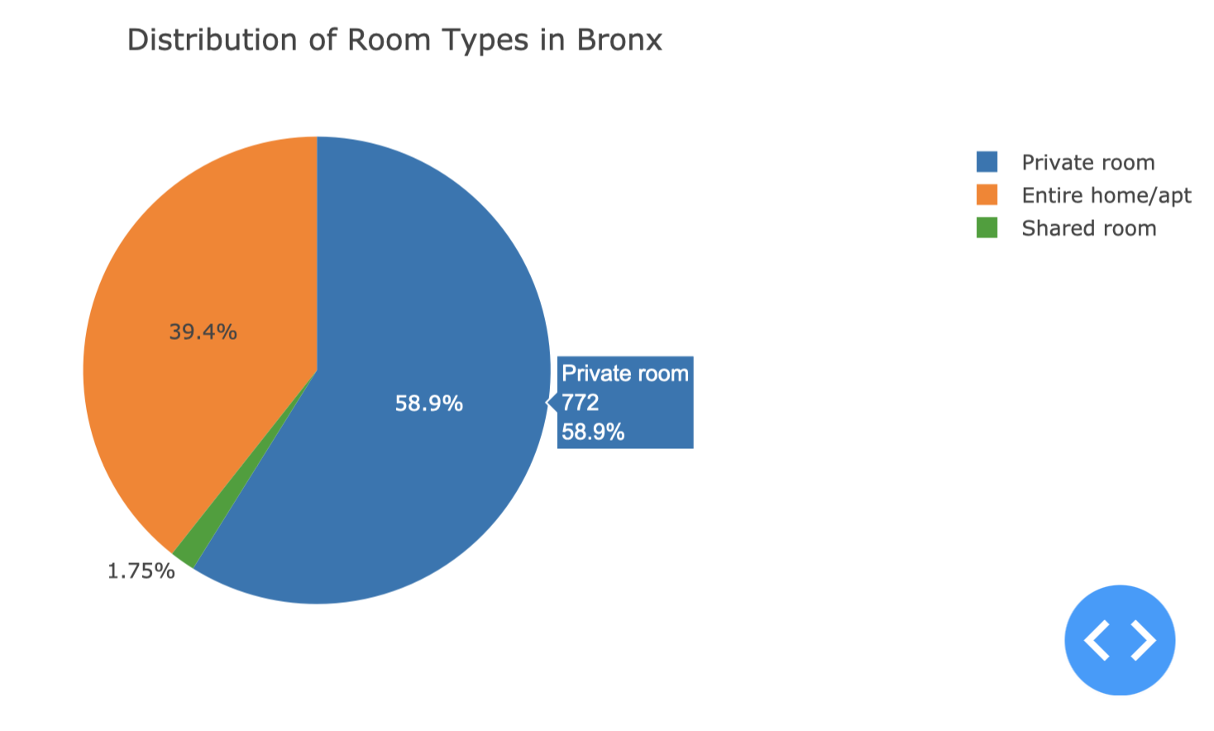

Slide 61
Summary:
Average Price Analysis:
Manhattan:
The average price is the highest among all boroughs.
Entire homes/apartments have the highest average price, indicating the demand for spacious accommodations in this prime location.
Hotel rooms also have high prices, reflecting the luxury accommodation options available.
Brooklyn:
Prices are lower compared to Manhattan but higher than Queens, Staten Island, and Bronx.
Entire homes/apartments have the highest average price, suggesting a demand for larger living spaces.
Private rooms and shared rooms have relatively lower prices, catering to budget-conscious travelers.
Queens:
Prices are generally lower compared to Manhattan and Brooklyn.
Entire homes/apartments have a moderate average price.
Private rooms and shared rooms offer more affordable options.
Staten Island:
Prices are the lowest among all boroughs.
Entire homes/apartments and shared rooms have comparable average prices, indicating a preference for communal living.
Hotel rooms and private rooms have slightly higher prices.
Bronx:
Prices are lower compared to Manhattan and Brooklyn but slightly higher than Staten Island.
Private rooms have the lowest average price, providing budget-friendly options.
Entire homes/apartments have moderate prices.

Slide 62
Room Type Distribution:
Manhattan:
Dominated by entire homes/apartments, which account for the majority of listings.
Private rooms are also popular, offering more affordable options for solo travelers or couples.
Brooklyn:
Similar to Manhattan, entire homes/apartments are the most common listing type.
Private rooms are also prevalent, catering to various traveler preferences.
Queens:
Entire homes/apartments and private rooms are almost equally distributed.
Shared rooms have a smaller share, indicating a lesser preference for communal living.
Staten Island:
Entire homes/apartments are the most common listing type, followed by private room.
Bronx:
Entire homes/apartments and private rooms are the most common listing types.
Shared rooms have a smaller share, similar to other boroughs.

Slide 63
Interactive Map Visualization

Slide 64
Can we add interactivity to allow users to filter neighborhood groups by price ranges?

Slide 65
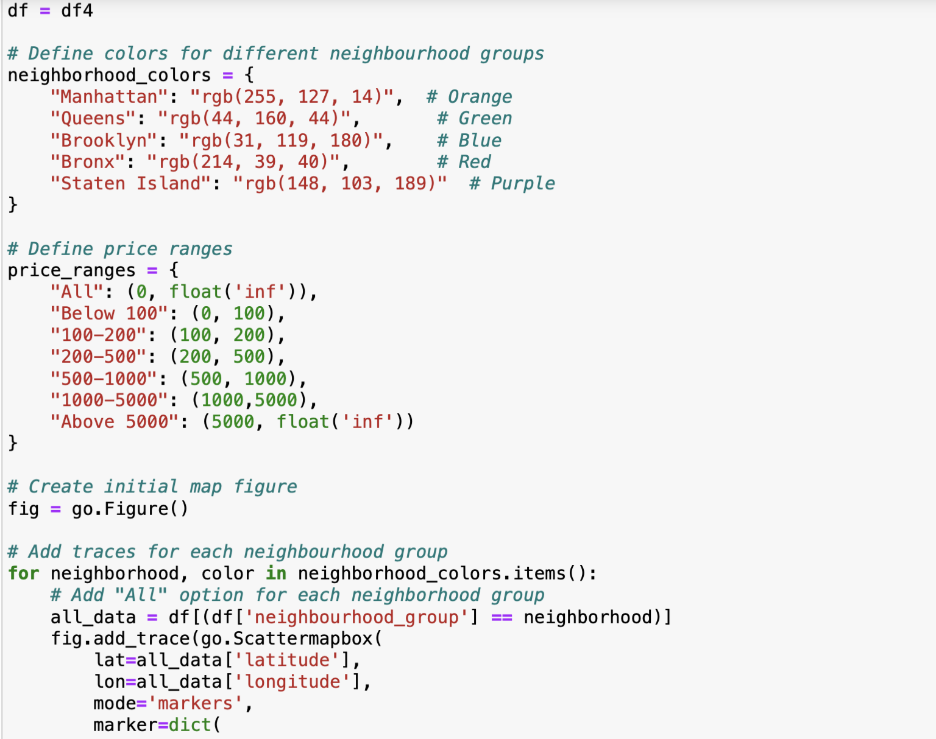
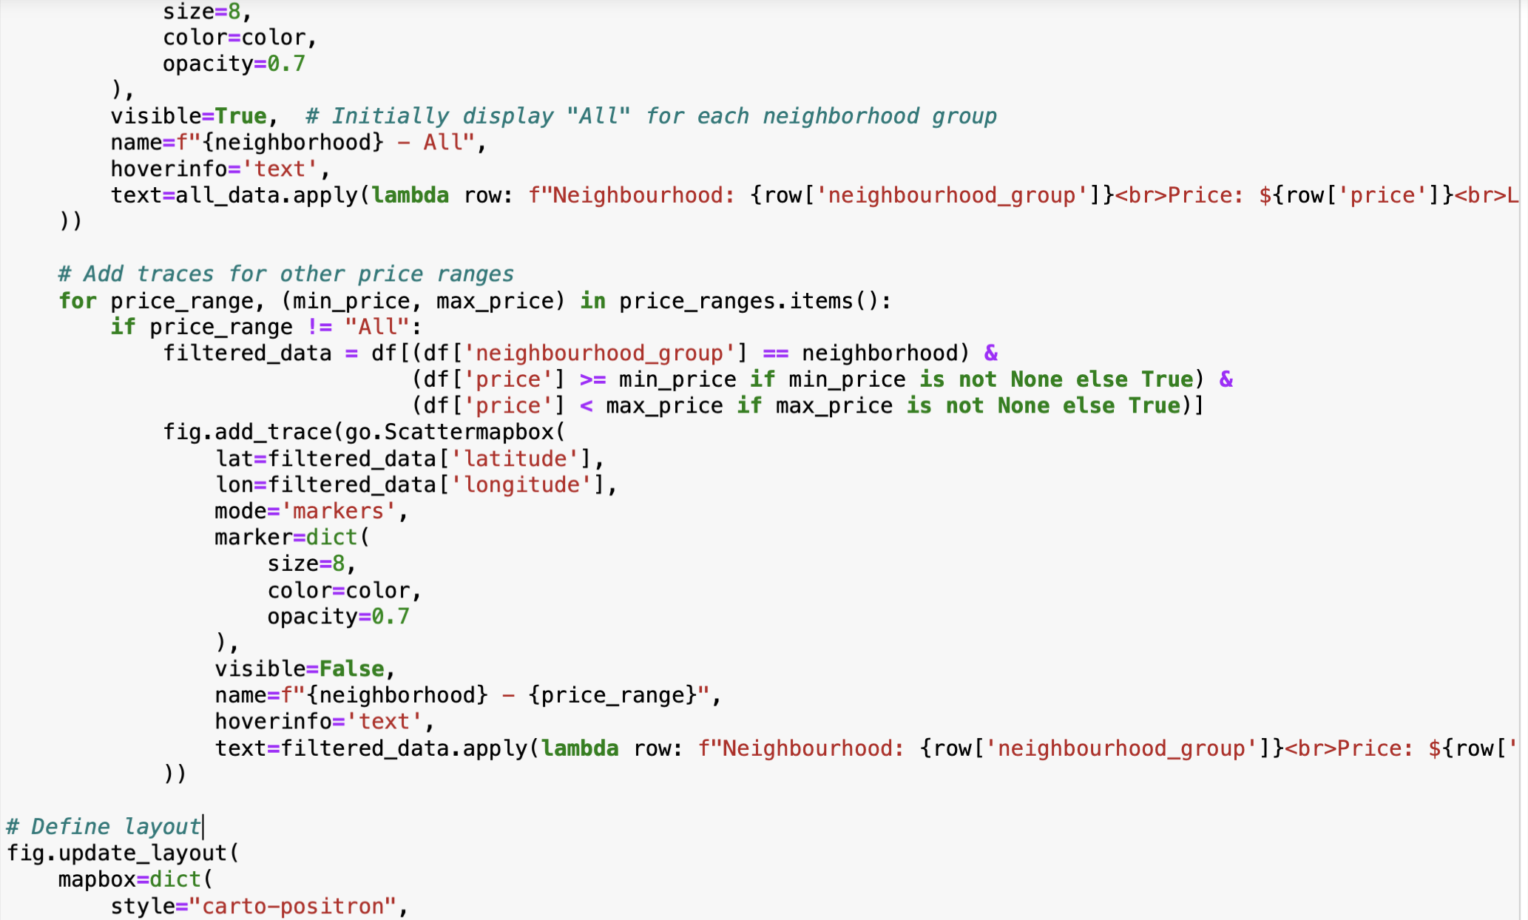
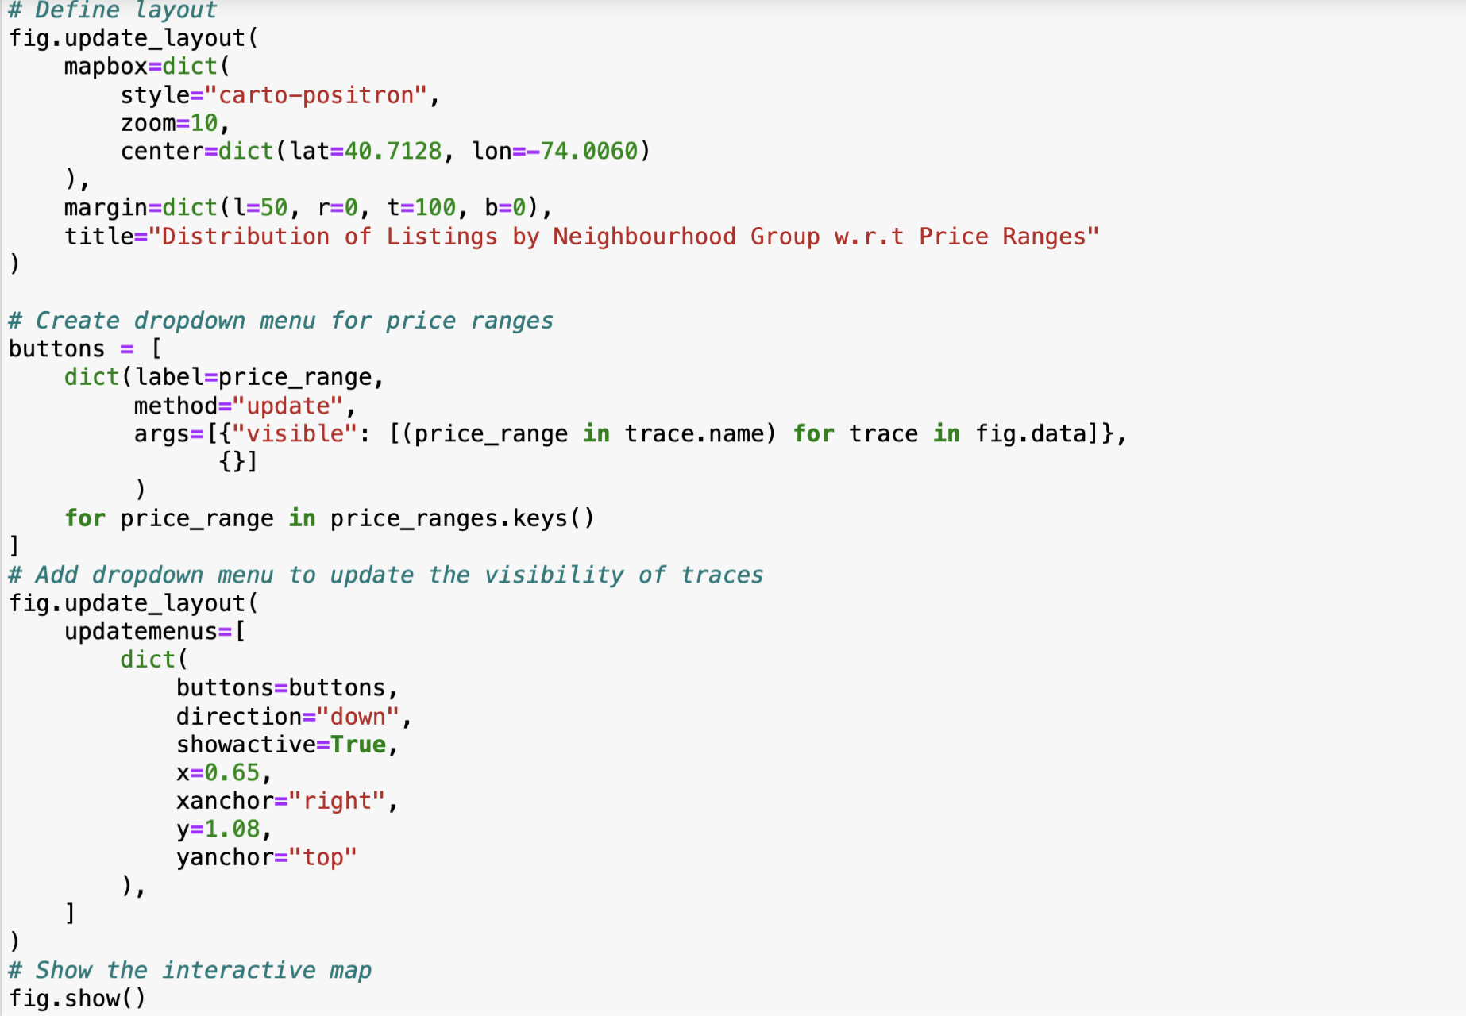
CODE

Slide 66
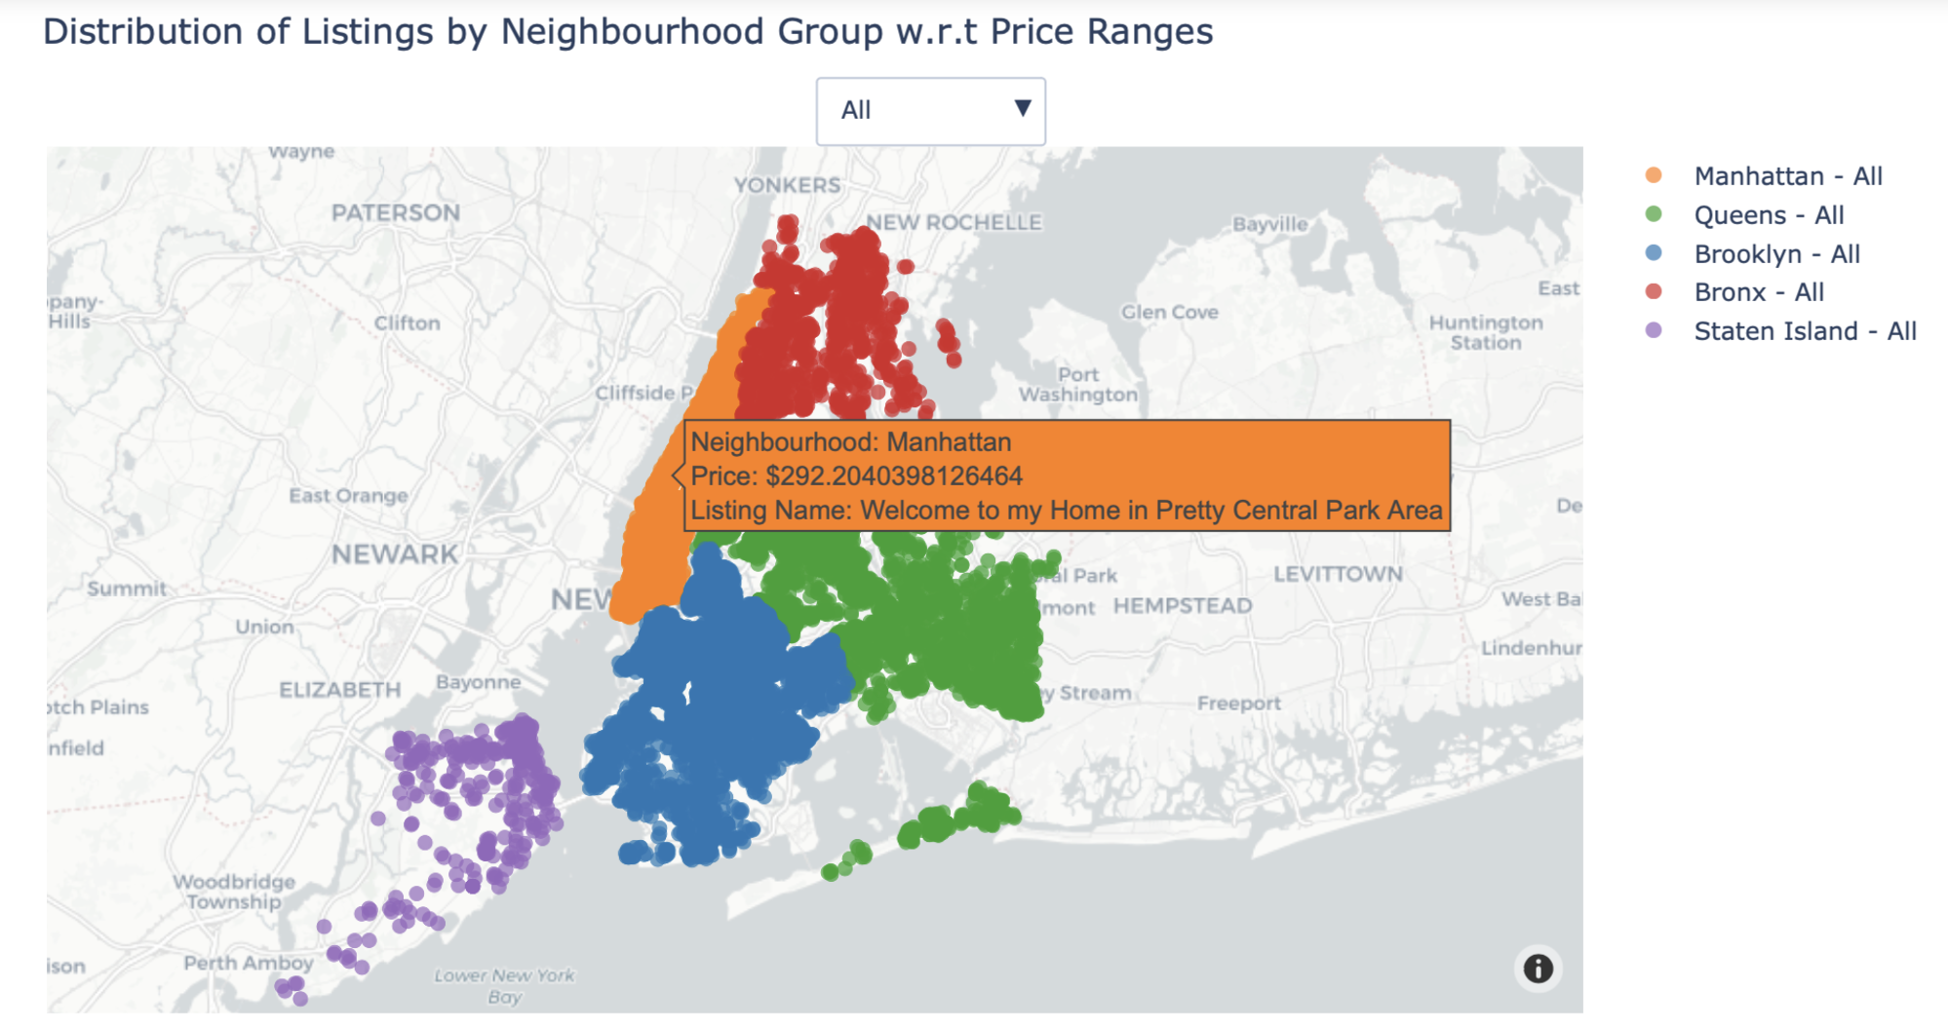
Interactive Map Visualization

Slide 67
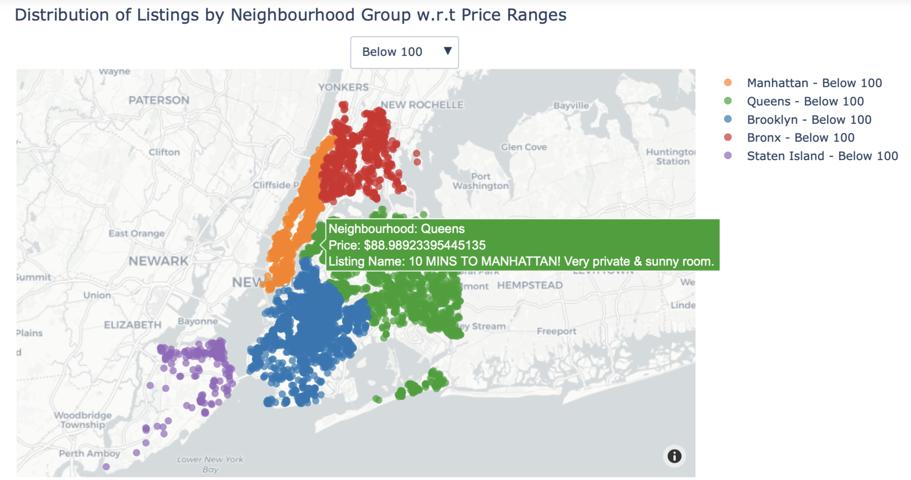

Slide 68
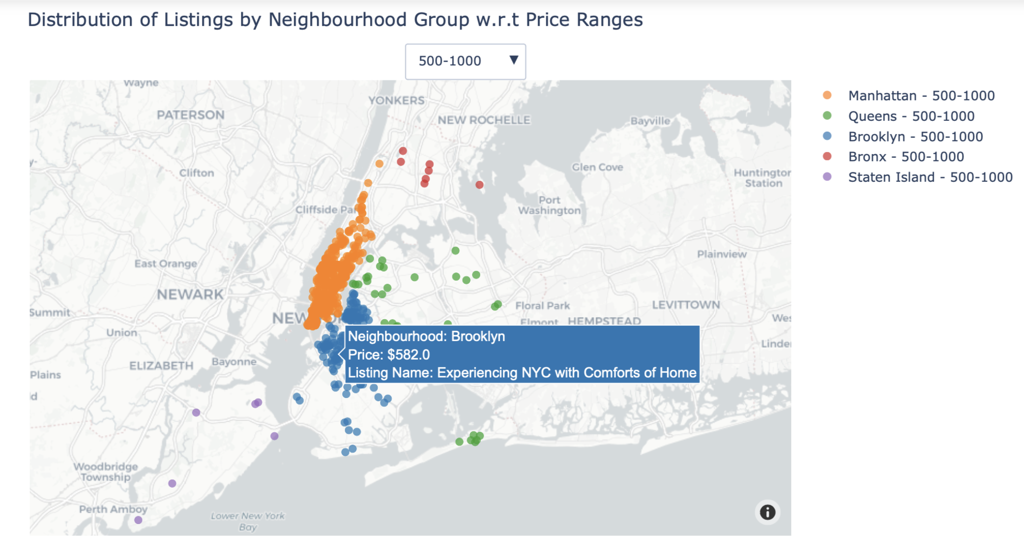

Slide 69
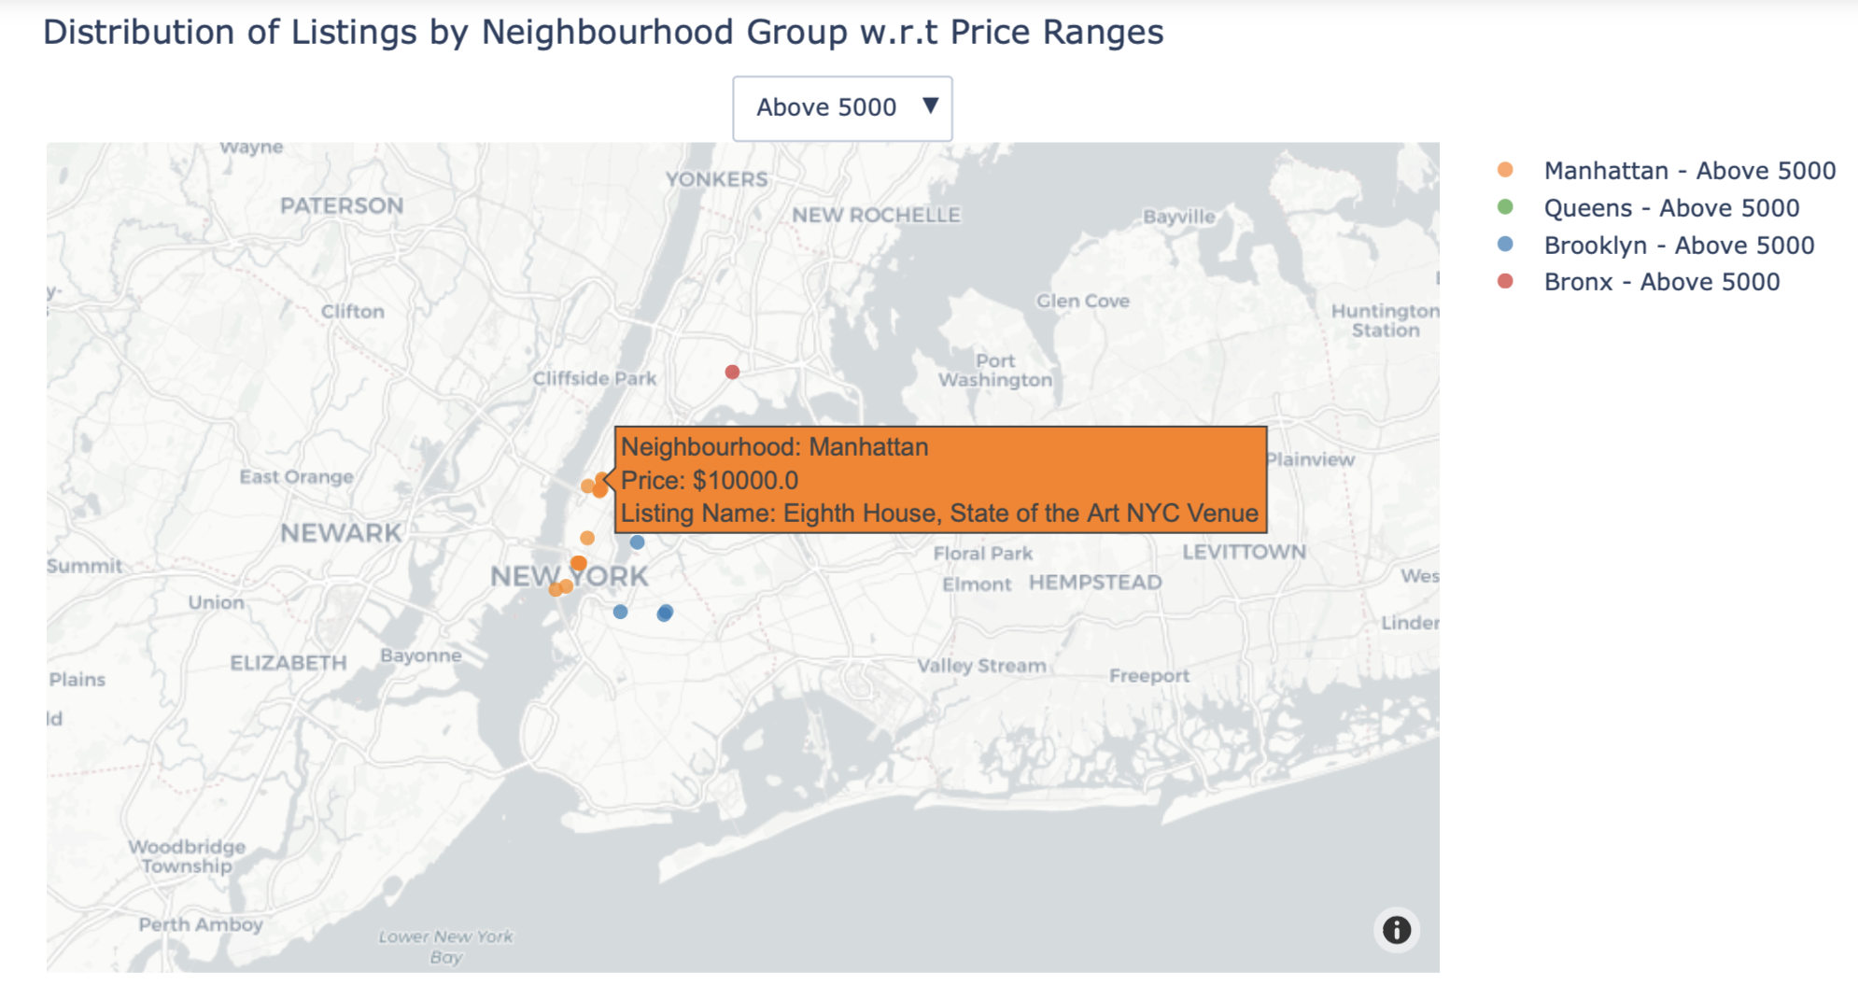

Slide 70
Summary:
Interactive Features:
Price Range Filtering: The interactive map allows us to filter listings based on their price ranges using the dropdown menu.
For example, we can select "Below 100" to view listings with prices below $100, or "100-200" to view listings with prices between $100 and $200.
Neighborhood Selection: We can also select specific neighborhoods by clicking on the corresponding legend entries.
Map Display:
The map displays the distribution of Airbnb listings across different neighborhoods in New York City.
Each marker represents a listing, with its position indicating its geographical location (latitude and longitude).
Color Coding: Listings are color-coded based on their neighborhood groups: Manhattan: Orange, Brooklyn: Blue, Queens: Green, Bronx: Red, Staten Island: Purple

Slide 71
Price Ranges:
Each neighborhood group is initially displayed with all listings (labeled as "All").
Upon selecting a specific price range from the dropdown menu, the map dynamically updates to display only the listings falling within that price range for each neighborhood.
For instance, selecting "Below 100" will show only the listings with prices below $100, while selecting "100-200" will display listings with prices between $100 and $200.
Hover Information:
Hovering over a marker reveals additional information about the listing, including the neighborhood group, price, and listing name.

Slide 72

CONCLUSION
We explored various aspects of Airbnb listings in New York City and gained valuable insights into the factors influencing pricing and review dynamics.
We examined the spatial distribution of Airbnb listings across different neighborhood groups, highlighting variations in average prices. This information is crucial for hosts seeking to invest in properties and optimize rental revenue.
Visualizing the distribution of listings by room type and price allowed us to understand the market demand for different types of accommodations. This insight helps both hosts and travelers make informed decisions about their preferences and budgets.
By analyzing the correlation between price and number of reviews, we discovered a notable trend: lower-priced listings tend to receive more reviews. This suggests the importance of competitive pricing and providing value to guests to enhance listing performance.
Recommendations:
For Hosts: Optimal pricing strategies, emphasizing value propositions, and encouraging positive guest experiences can lead to increased revenue and better performance in the Airbnb market.
For Travelers: Understanding pricing dynamics and room type distributions helps in making informed decisions about accommodation options.
For Stakeholders: Further analysis and strategic adjustments based on these insights can enhance the competitiveness of listings and contribute to the overall success of the Airbnb ecosystem.

Slide 73
Thank You

